Slide 1
Securing a Microsoft ASP.NET Web Application

Slide 2
Overview
Web Application Security Overview
Working with Windows-Based Authentication
Working with Forms-Based Authentication
Overview of Microsoft Passport Authentication
Notes:
Tổng quan về bảo mật ứng dụng web, Làm việc với xác thực windows-Based, Làm việc với xác thực Forms-Based, Tổng quan của xác thực Microsoft Passport

Slide 3
Lesson: Web Application Security Overview
Authentication vs. Authorization
What Are ASP.NET Authentication Methods?
Multimedia: ASP.NET Authentication Methods
Comparing the ASP.NET Authentication Methods
What Are the IIS Authentication Mechanisms?
Demonstration: Using IIS Authentication Mechanisms
What Is Secure Sockets Layer?
Notes:
Chứng thực và cho phép, Phương thức xác thực asp.net là gì? Trình bầy về phương thức xác thực asp.net, so sánh các phương thức xác thực asp.net, Cơ chế xác thực IIS là gì? Hướng dẫn sử dụng cơ chế xác thực IIS, Secure Sockets Layer là gì?

Slide 4
Authentication vs. Authorization
Authentication
Accepts credentials from a user
Validates the credentials
Authorization
Given the authentication credentials supplied, determines the right to access a resource
Can be assigned by user name or by role
Notes:
Xác thực 1, là xác thực thông tin từ một người sử dụng, 2 xác nhận các thông tin | Cho phép : Với thông tin xác thực được cung cấp, xác thực quyền truy cập vào một tài nguyên có thể được chỉ định bởi người dùng hoặc vai trò

Slide 5
What Are ASP.NET Authentication Methods?
Windows-based authentication
Relies on the Windows operating system and IIS
User requests a secure Web page and the request goes through IIS
After credentials are verified by IIS, the secure Web page is returned
Forms-based authentication
Unauthenticated requests are redirected to an HTML form
User provides credentials and submits the HTML form
After credentials are verified, an authentication cookie is issued
Microsoft Passport authentication
Centralized authentication service that offers a single logon option
Microsoft Passport is an XML Web service
Notes:
Xác thực dự trên windown: 1, dựa trên hệ điều hành windowns và IIS 2,Người dung yêu cầu trang web an toàn và đi qua IIS 3, Sau khi được xác nhận thì bởi IIS, trang web sẽ được trả về. | Xác thực dựa trên Form: 4,Yêu cầu không được xác nhận mà chuyển hướng sang một Form HTML 5, Người dung cung cấp các thông tin và gửi HTML Form 6,Sau khi được xác nhận thì một cookie được sử dụng. | Xác thực Microsoft Passport: Dịch vụ xác thực cung cấp một lựa chọn đăng nhập duy nhất, Microsoft Passport là một dịch vụ web XML

Slide 6

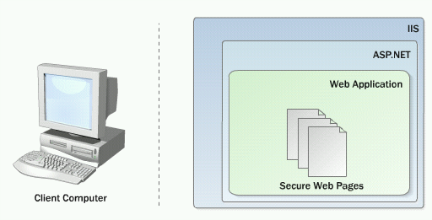

Multimedia: ASP.NET Authentication Methods

Slide 7
Comparing the ASP.NET Authentication Methods
Method | Advantages | Disadvantages
Windows-based Authentication | Uses existing Windows infrastructure Controls access to sensitive information | Not appropriate for most Internet applications
Forms-based Authentication | Good for Internet applications Supports all client types | Based on cookies
Microsoft Passport Authentication | Single sign in for many Internet sites No need to maintain a database to store user information Allows developers to customize the appearance of the registration page | Based on cookies Fees involved
Notes:
(Lợi thế) Sử dụng hạ tầng cơ sở windowns, điều khiển truy cập thông tin nhạy cảm. - Tốt cho ứng dụng trên internet, hỗ trợ tất cả các loại máy client – Đăng nhập duy nhất trong nhiều các trang web Internet, Không cần phải duy trì một cơ sở dữ liệu để lưu trữ thông tin người dùng , Cho phép các nhà phát triển để tùy chỉnh sự xuất hiện của trang đăng ký
(Bất lợi) Không thích hợp cho hầu hết các ứng dụng Internet - Dựa trên cookie lệ phí liên quan

Slide 8
What Are the IIS Authentication Mechanisms?
Mechanisms | Security Level | Description
Anonymous | None | No authentication occurs
Basic | Low (Medium with SSL) | Client sends username and password as clear text Can be encrypted by using SSL Part of the HTTP specification and supported by most browsers
Digest | Medium | Sends information as encoded hash Requires Internet Explorer 5 or later Requires Active Directory
Integrated Windows | High | Uses either NTLM or Kerberos Generally good for intranets, not Internet Does not work through most firewalls

Slide 9

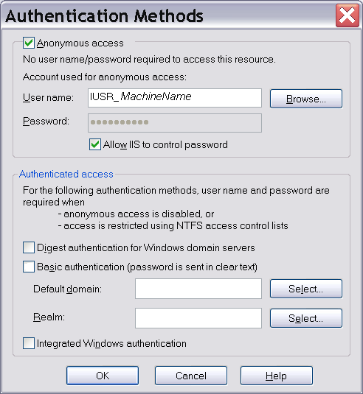
Demonstration: Using IIS Authentication Mechanisms
Right-click Mod16 and then click Properties
Click Directory Security tab
Click Edit
Show the authentication
methods

Slide 10
What Is Secure Sockets Layer?
SSL is a protocol used for transmitting data securely across a network. SSL secures data through:
Data encryption
-Ensures that the data sent is read only by a secure target server
Server authentication
-Ensures that data is sent to the correct server
-Uses the server and client certificates
Data integrity
-Protects the integrity of the data
-Includes a message authentication code that detects whether a message is altered
Uses Hypertext Transfer Protocol Secure to retrieve an ASP.NET Web page

Slide 11
Lesson: Working with Windows-Based Authentication
How to Enable Windows-Based Authentication
Reading User Information
Demonstration: Using Windows-Based Authentication

Slide 12
How to Enable Windows-Based Authentication
Configure IIS to use one or more of the following authentication mechanisms:
Basic
Digest
Integrated Windows security
Set Windows-based authentication in Web.config
1
2
<system.web>
<authentication mode="Windows" />
</system.web>

Slide 13
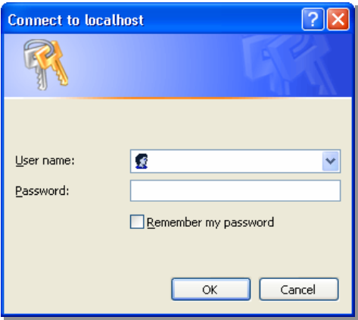
How to Enable Windows-Based Authentication (continued)
3
Set up authorization in Web.config
When users access the Web Form, IIS requests logon information
<location path="ShoppingCart.aspx">
<system.web>
<authorization>
<deny users="?"/>
</authorization>
</system.web>
</location>
4

Slide 14
Reading User Information
After authentication, the Web server can read the user identity
lblAuthUser.Text = User.Identity.Name
lblAuthType.Text = User.Identity.AuthenticationType
lblIsAuth.Text = User.Identity.IsAuthenticated
lblAuthUser.Text = User.Identity.Name;
lblAuthType.Text = User.Identity.AuthenticationType;
lblIsAuth.Text = User.Identity.IsAuthenticated;

Slide 15
Demonstration: Using Windows-Based Authentication
Open IIS and configure with Anonymous authentication only
Create a new user on the local machine
Open Web.config and configure it for authentication and authorization
Run the secure ASP.NET Web application
Students can access the secure ASP.NET Web application on the Instructor machine

Slide 16
Lesson: Working with Forms-Based Authentication
Overview of Forms-Based Authentication
Multimedia: Forms-Based Authentication
How to Enable Forms-Based Authentication
Creating a Logon Page
Demonstration: Using Forms-Based Authentication

Slide 17
Overview of Forms-Based Authentication
1
IIS
2
ASP.NET Forms Authentication
✗
Not Authenticated
Authenticated
Client requests page
6
Username
Access Denied
Someone
4
Authorized
✗
Password
Logon Page (Users enter their credentials)
***********
Not Authenticated
Submit
3
Authenticated
Authentication Cookie
Authorized
7
Requested Secure Page
5

Slide 18
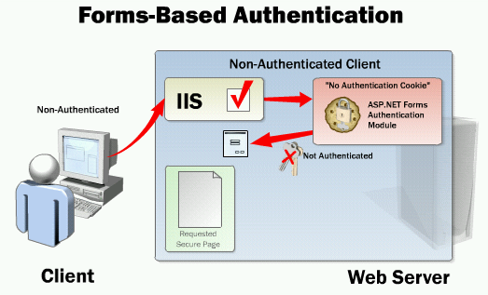
Multimedia: Forms-Based Authentication

Slide 19
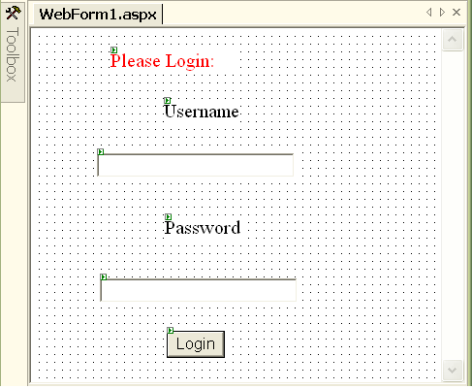
How to Enable Forms-Based Authentication
Configure IIS to use Anonymous authentication
Set Forms-based authentication in Web.config
Set up authorization
Build a Logon Web Form
1
2
<authentication mode="Forms" >
<forms name=".namesuffix"
loginUrl="login.aspx" />
</authentication>
3
4

Slide 20
Creating a Logon Page
Reference System.Web.Security
Logon page verifies and checks the credentials of a user
Reading user credentials from a cookie
User.Identity.Name returns the value saved by FormsAuthentication.RedirectFromLoginPage
private void cmdLogin_Click(object sender, EventArgs e)
{
if (login(txtEmail.Text, txtPassword.Text))
FormsAuthentication.RedirectFromLoginPage(txtEmail.Text, false);
}
Sub cmdLogin_Click(s As Object, e As eventArgs)
If (login(txtEmail.Text, txtPassword.Text))
FormsAuthentication.RedirectFromLoginPage(txtEmail.Text, False)
End If
End Sub

Slide 21
Demonstration: Using Forms-Based Authentication
Open IIS and configure for Anonymous authentication
Open Web.config and configure for authentication and authorization
Open logon page and show code
Run the ASP.NET Web application
Students can access the secure ASP.NET Web application on the Instructor machine

Slide 22
Lesson: Overview of Microsoft Passport Authentication
How Microsoft Passport Works
Other Microsoft Passport Resources

Slide 23
How Microsoft Passport Works
1
The client requests a page from the host
Website.msft
2
The site redirects the client to Passport.com
3
The client is redirected and logs on to Passport.com
4
Passport returns a cookie with the ticket information
5
The client accesses the host, this time with ticket information
Client
6
The host returns a Web Form and possibly a new cookie that it can read and write
Passport.com

Slide 24
DEMO
Run in IE
Lesson04.2_Authentiaction.swf
Lesson04.2_form base authentication demo.swf

